Slide 1
Image Representation, Description, and Recognition
Notes:
1

Slide 2
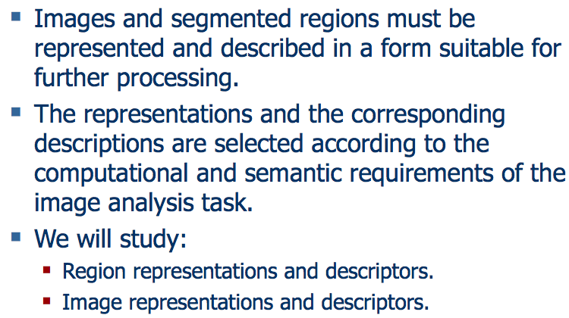
Representation and Description
Notes:
2

Slide 3
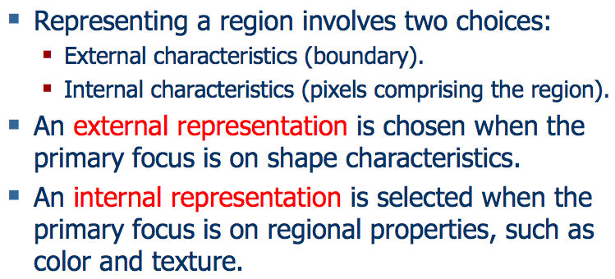
Representation and Description
Notes:
3

Slide 4
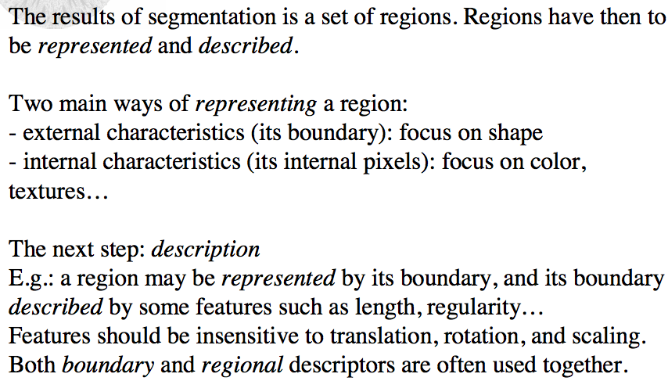
Representation and Description
Notes:
4

Slide 5
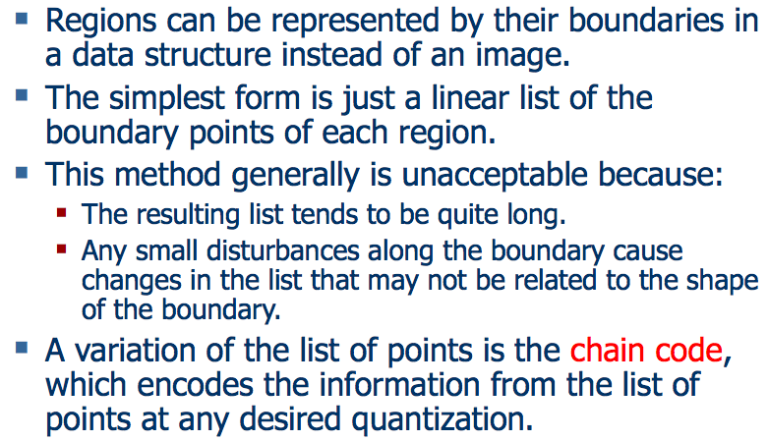
Chain Codes
Notes:
5

Slide 6
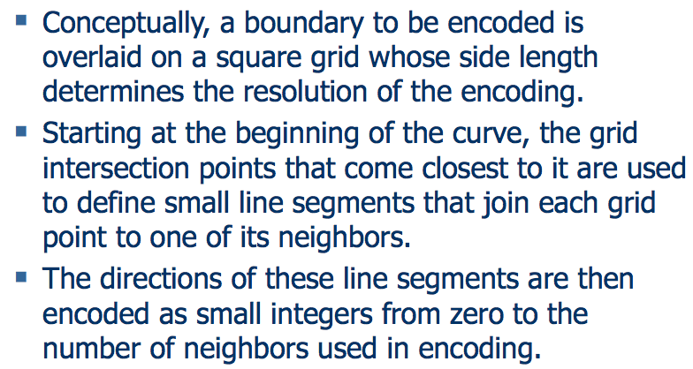
Chain Codes
Notes:
6

Slide 7
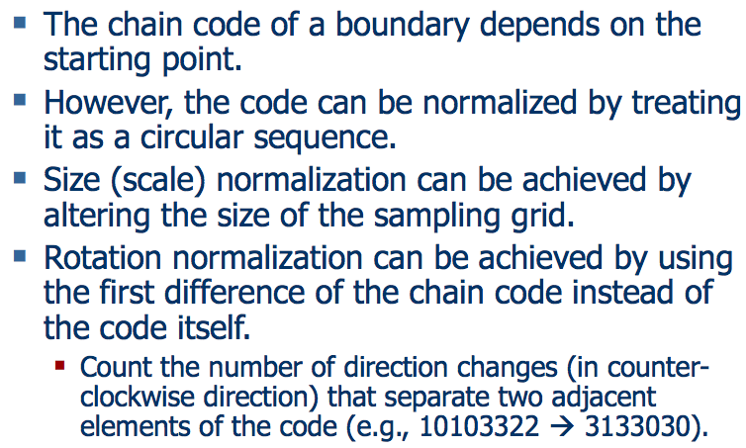
Chain Codes
Notes:
7

Slide 8
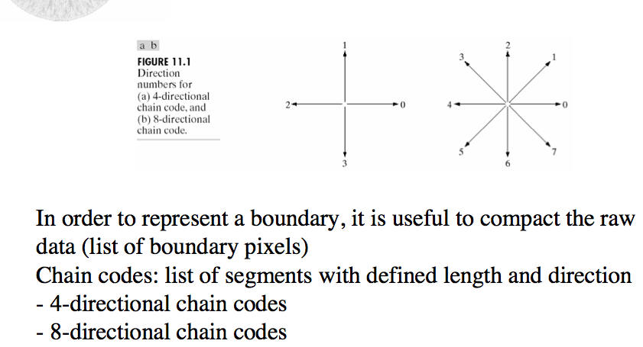
Chain Codes
Notes:
8

Slide 9
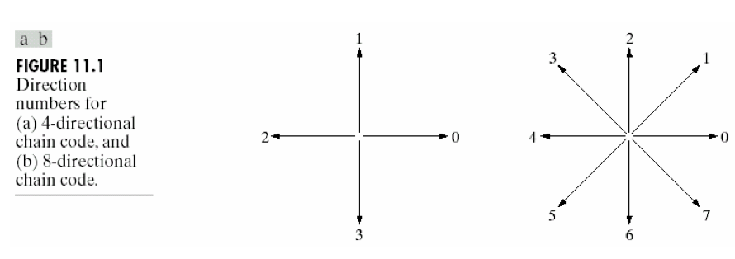
Chain Codes
Notes:
9

Slide 10
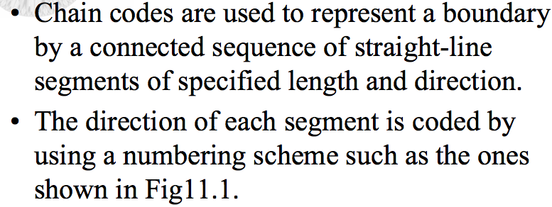
Chain Codes
Notes:
10

Slide 11
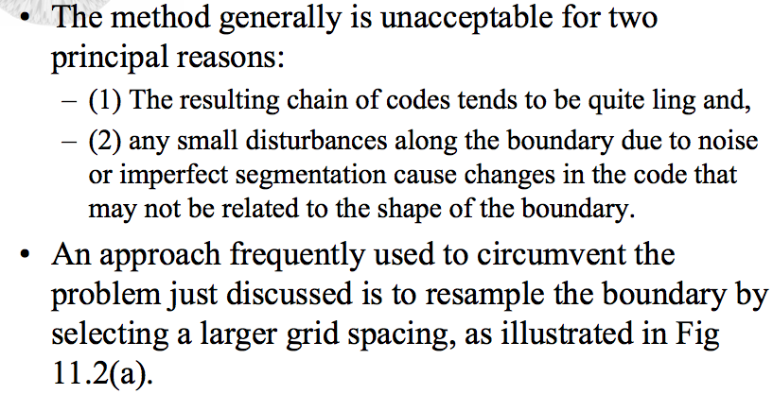
Chain Codes
Notes:
11

Slide 12
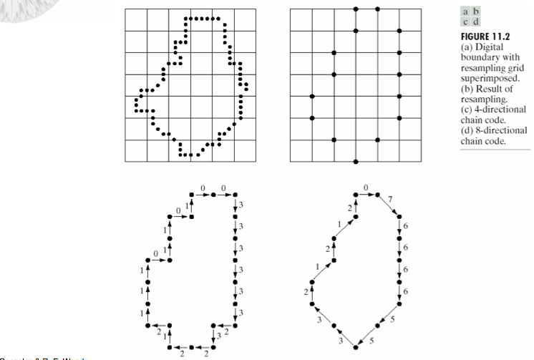
Chain Codes
Notes:
12

Slide 13
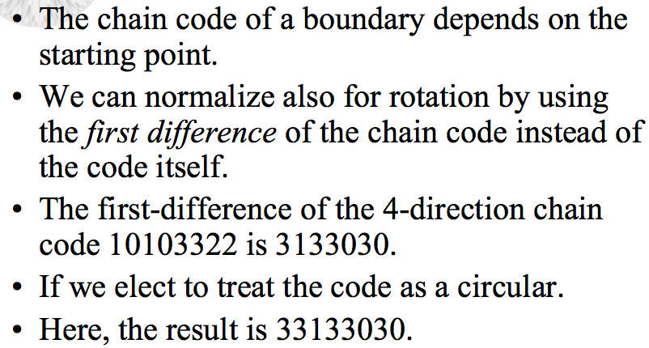
Chain Codes
Notes:
13

Slide 14
Chain Codes
Notes:
14

Slide 15
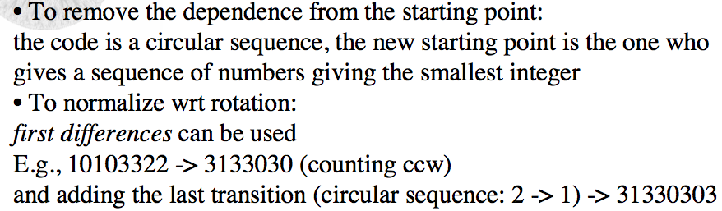
Chain Codes
Notes:
15

Slide 16
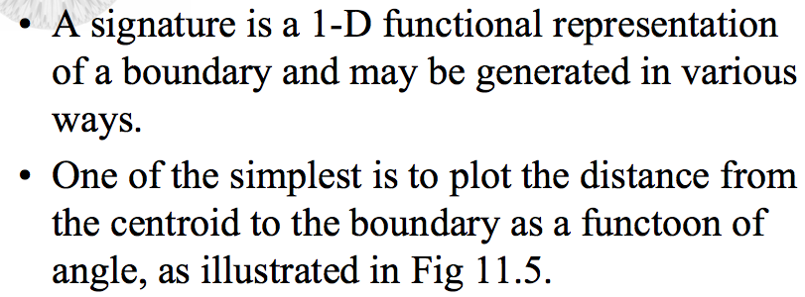
Signatures
Notes:
16

Slide 17
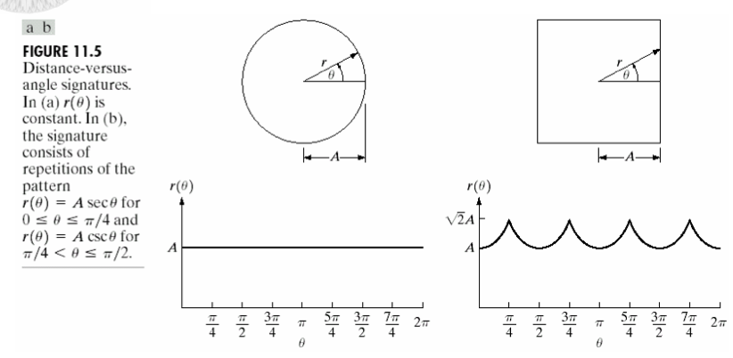
Signatures
Notes:
17

Slide 18
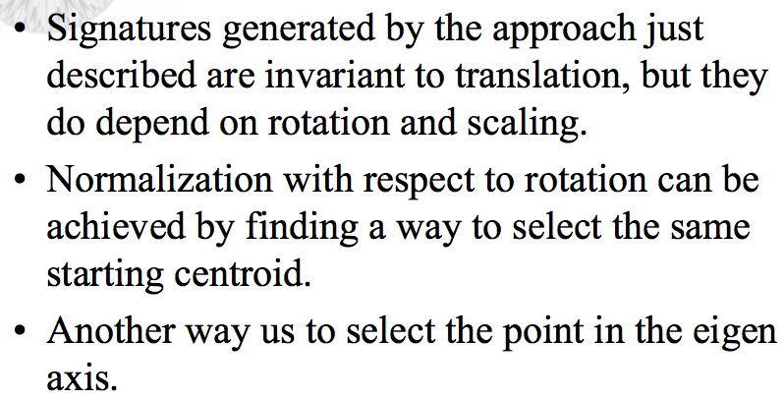
Signatures
Notes:
18

Slide 19
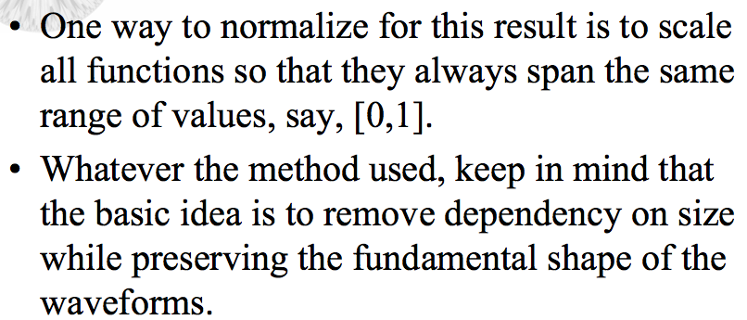
Signatures
Notes:
19

Slide 20
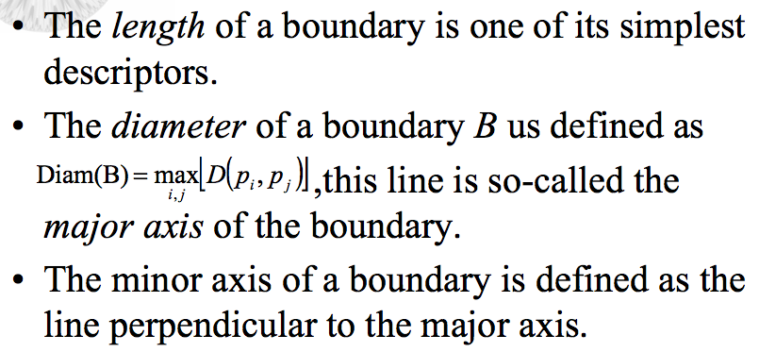
Some Simple Descriptors
Notes:
20

Slide 21
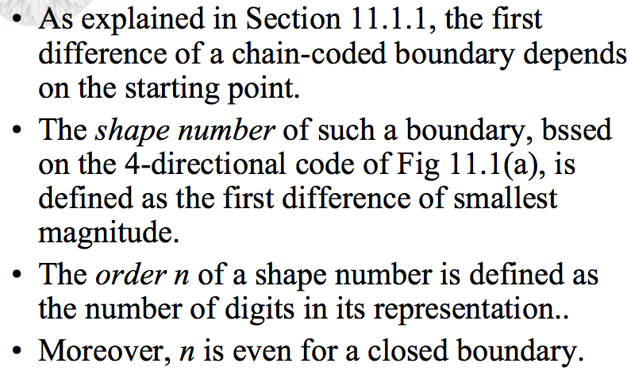
Shape Numbers
Notes:
21

Slide 22
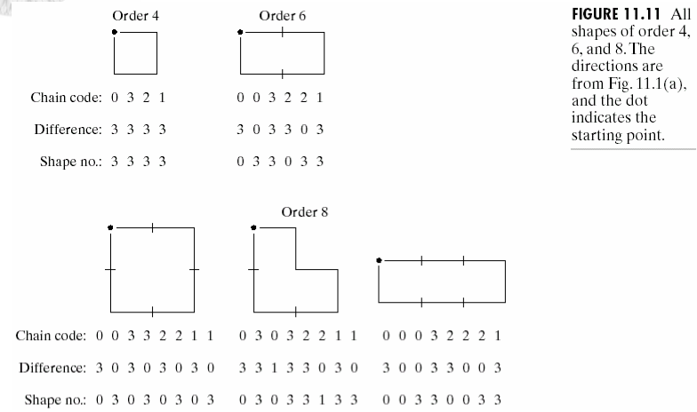
Shape Numbers
Notes:
22

Slide 23
Shape Numbers
Notes:
23

Slide 24
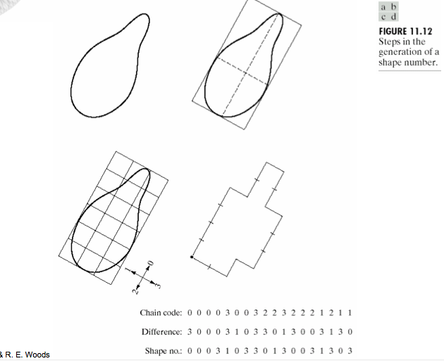
Shape Numbers
Notes:
24

Slide 25
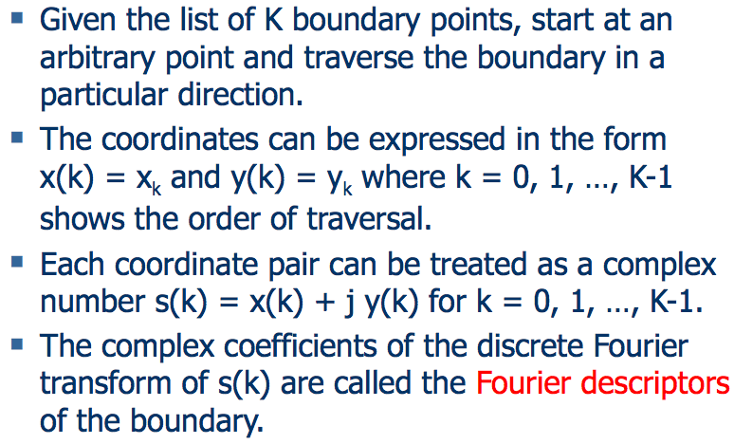
Fourier Descriptors
Notes:
25

Slide 26
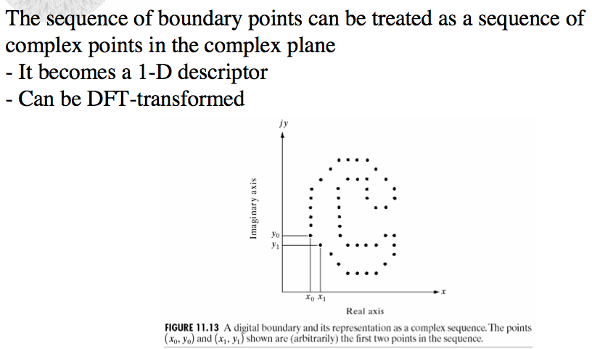
Fourier Descriptors
Notes:
26

Slide 27
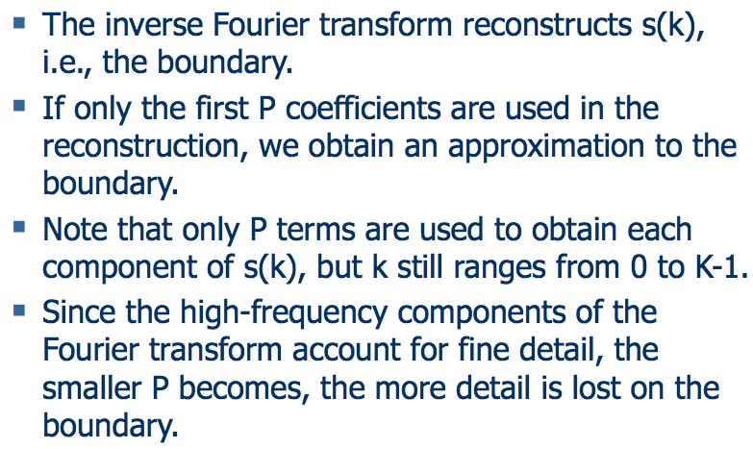
Fourier Descriptors
Notes:
27

Slide 28
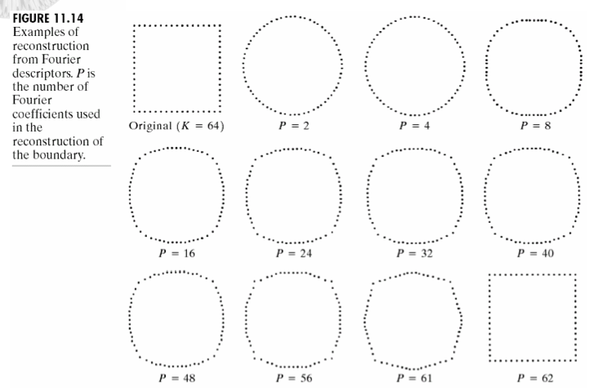
Fourier Descriptors
Notes:
28

Slide 29
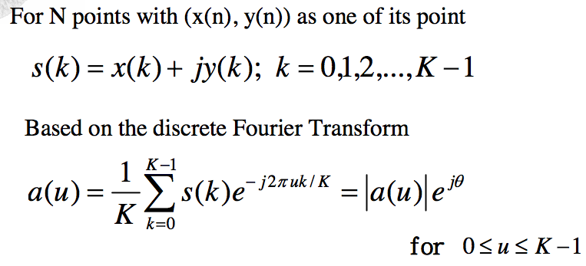



Fourier Descriptors
If only first P Fourier Coefficients are used.
Notes:
29

Slide 30
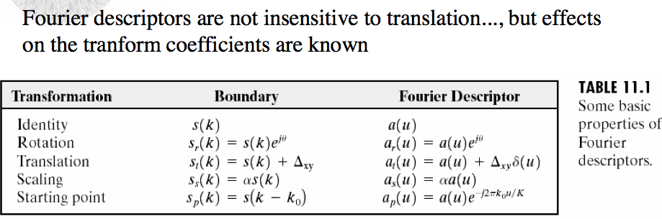
Fourier Descriptors
Notes:
30

Slide 31
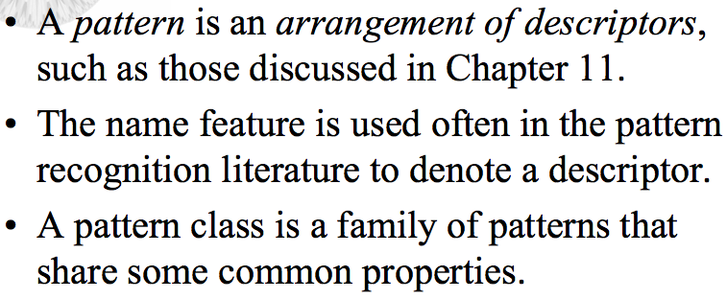
Pattern and Pattern Classes
Notes:
31

Slide 32
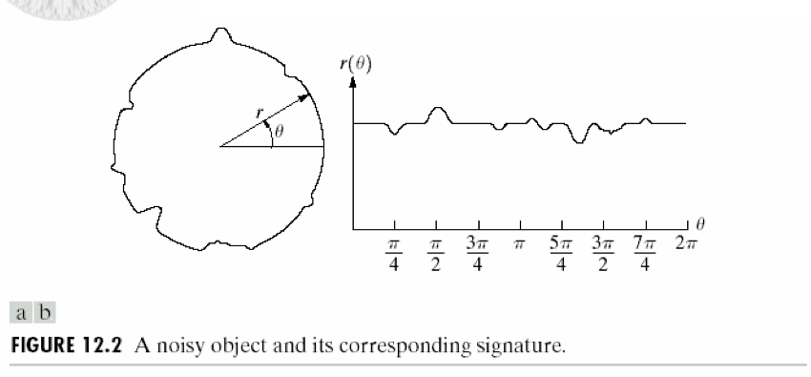
Object Recognition
Notes:
32

Slide 33
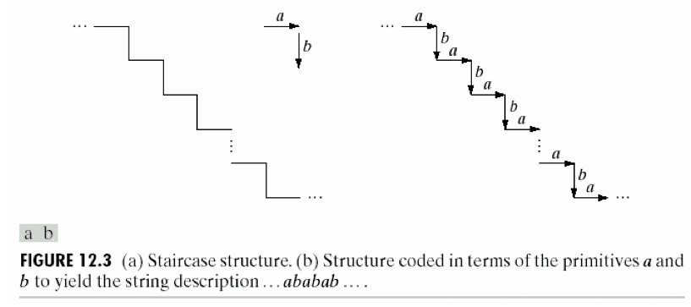
Object Recognition
Notes:
33

Slide 34
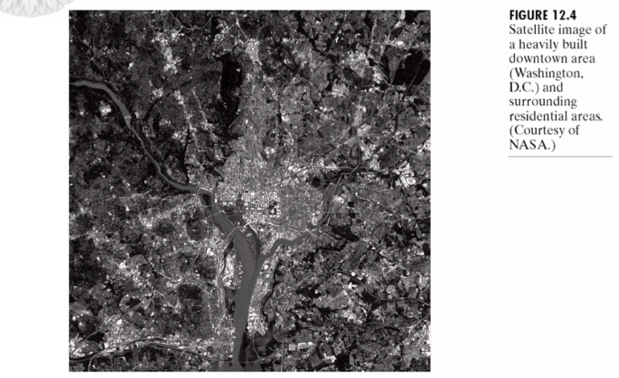
Object Recognition
Notes:
34

Slide 35
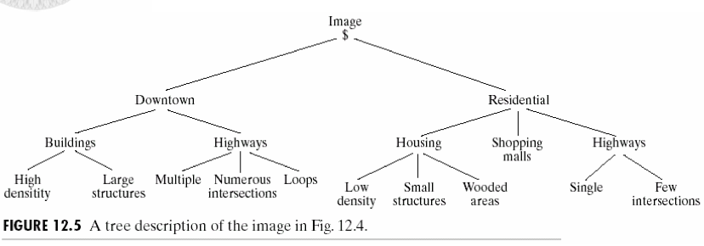
Object Recognition
Notes:
35

Slide 36
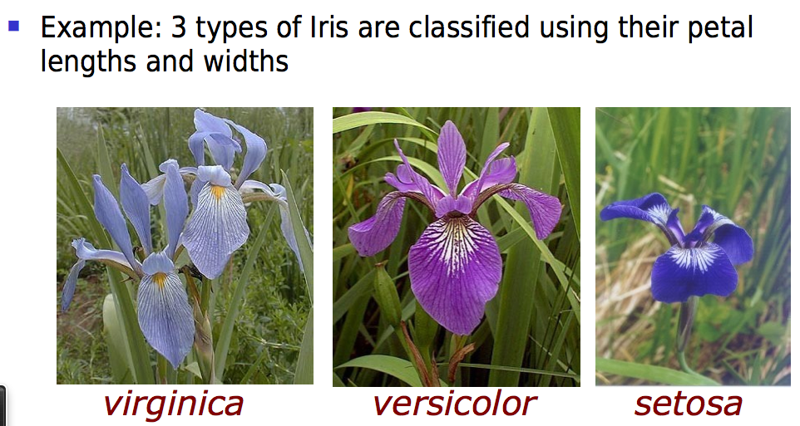
Object Recognition
Notes:
36

Slide 37
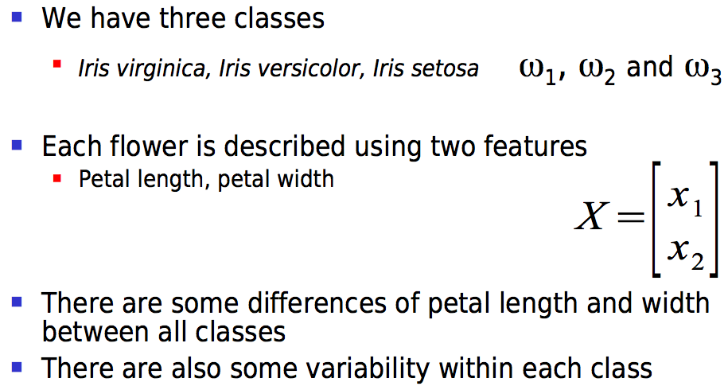
Object Recognition
Notes:
37

Slide 38
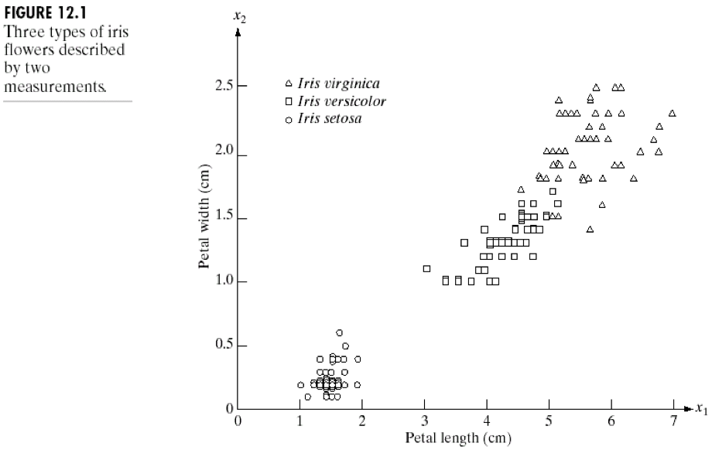
Object Recognition
Notes:
38

Slide 39
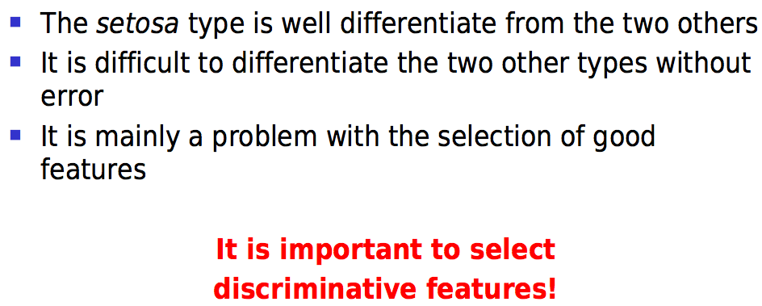
Object Recognition
Notes:
39

Slide 40
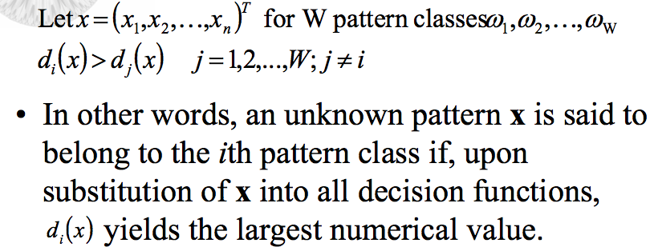
Recognition Based on Decision Theoretic Methods
Notes:
40

Slide 41
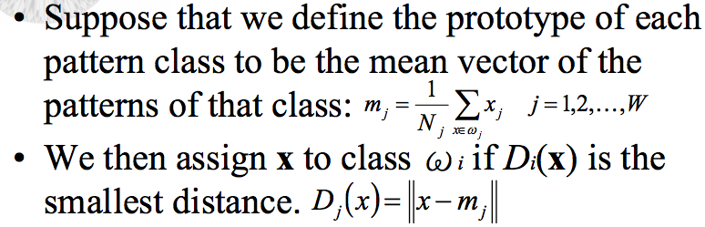
Minimum Distance Classifier
Notes:
41

Slide 42
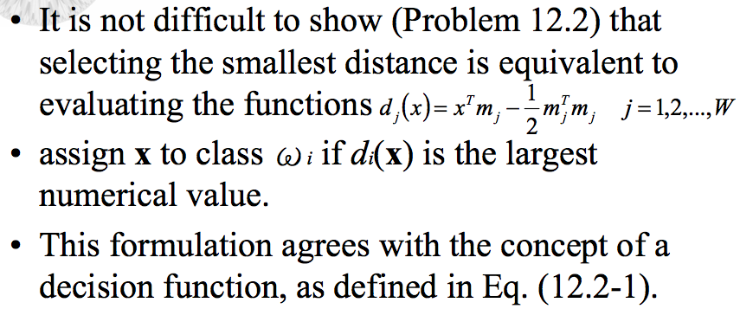
Minimum Distance Classifier
Notes:
42

Slide 43
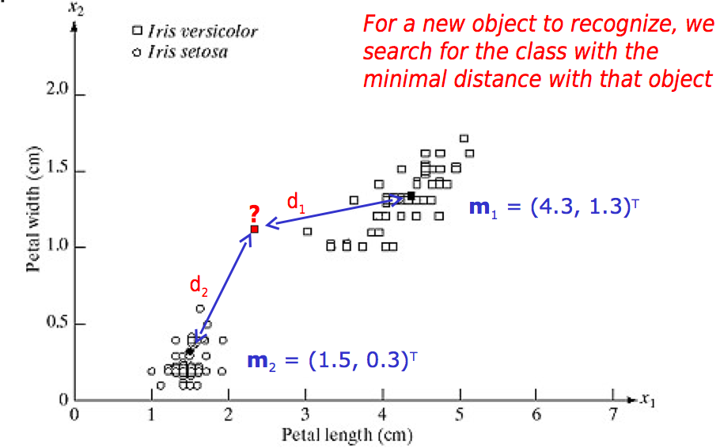
Minimum Distance Classifier
Notes:
43

Slide 44
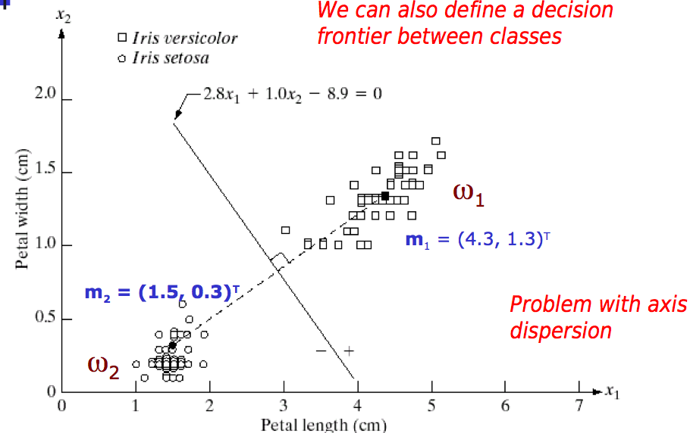
Minimum Distance Classifier
Notes:
44

Slide 45
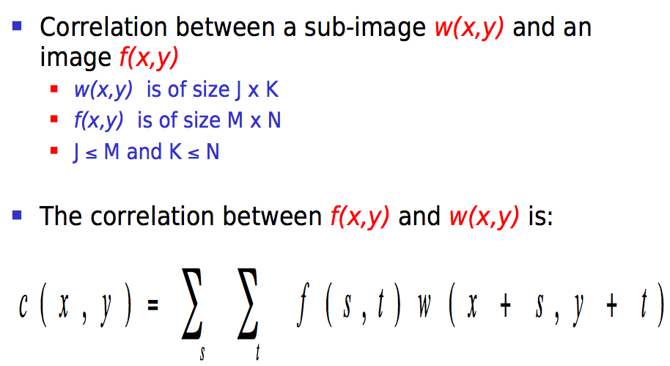
Matching By Correlation
Notes:
45

Slide 46
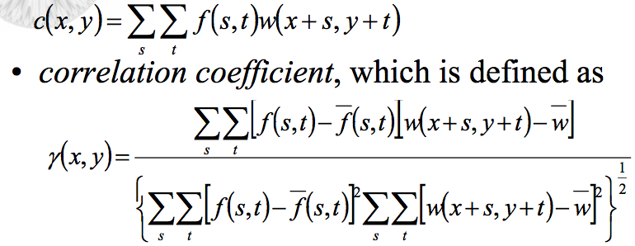
Matching By Correlation
Notes:
46

Slide 47
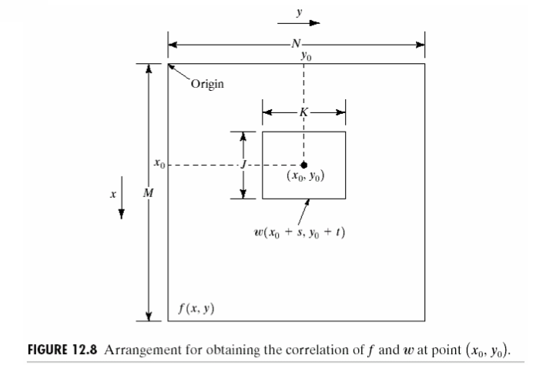
Matching By Correlation
Notes:
47

Slide 48
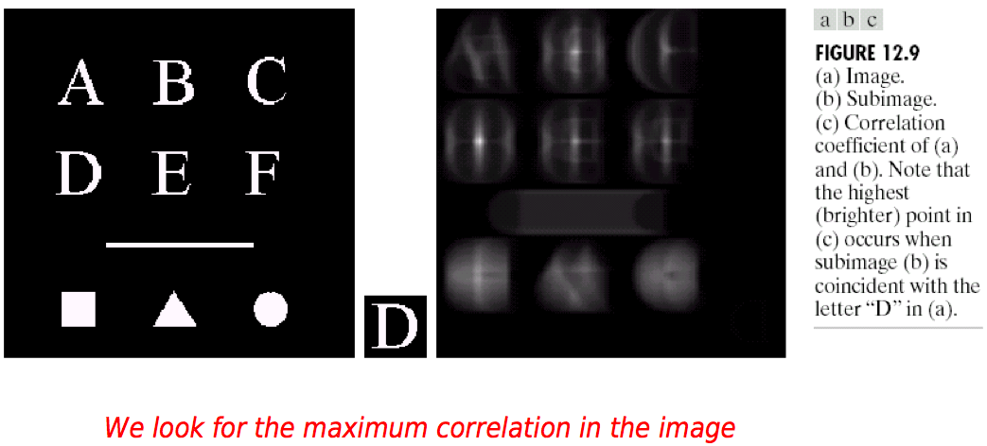
Matching By Correlation
Notes:
48

Slide 49
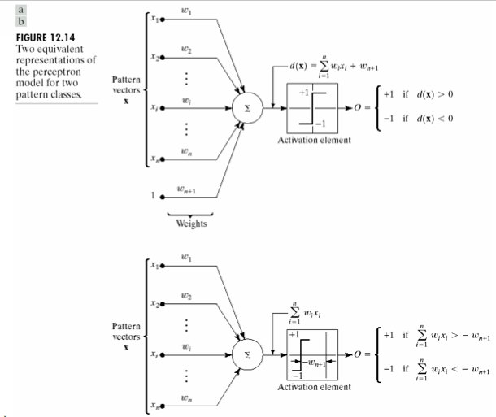
Neural Network
Notes:
49

Slide 50



Neural Network : Training Algorithm
Notes:
50

Slide 51
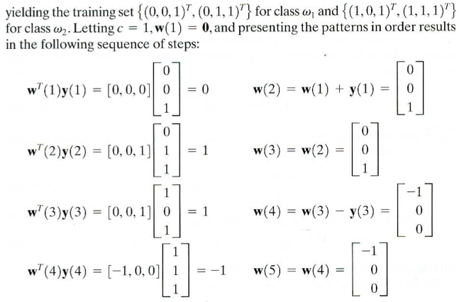
Neural Network : Training Algorithm
Notes:
51

Slide 52
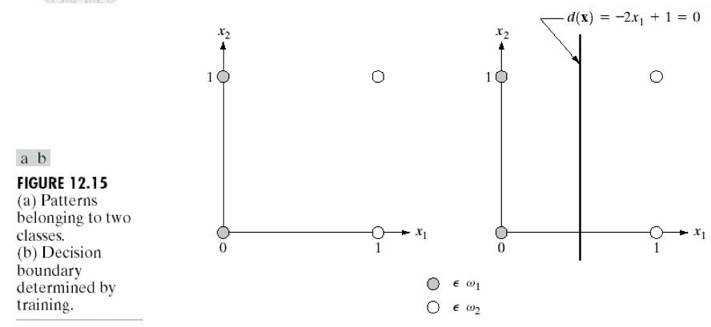
Neural Network : Training Algorithm
Notes:
52

Slide 53

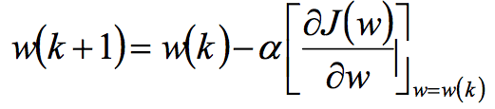

Neural Network : Training Algorithm
Notes:
53

Slide 54
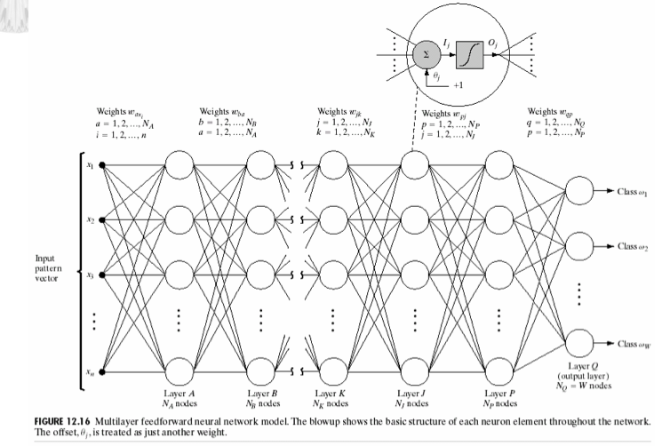
Neural Network : Training Algorithm
Notes:
54

Slide 55

Neural Network : Training Algorithm
http://en.wikipedia.org/wiki/Hopfield_network
http://home.agh.edu.pl/~vlsi/AI/hamming_en/
Notes:
55

Slide 56

Hamming Neural Network
Notes:
56

Slide 57

Hopfield Neural Network
Notes:
57

Slide 58

Human Perception
Notes:
58

Slide 59

What is a Pattern Recognition?
Notes:
59

Slide 60

Pattern Recognition Applications
Notes:
60

Slide 61

An Example
Notes:
61

Slide 62

An Example : Decision Process
Notes:
62

Slide 63

An Example : Selecting Features
Notes:
63

Slide 64

An Example : Selecting Features
Notes:
64

Slide 65

An Example : Selecting Features
Notes:
65

Slide 66

An Example : Selecting Features
Notes:
66

Slide 67

An Example : Cost of Error
Notes:
67

Slide 68

An Example : Cost of Error
Notes:
68

Slide 69

An Example : Multiple Features
Notes:
69

Slide 70

An Example : Multiple Features
Notes:
70

Slide 71

An Example : Decision Boundaries
Notes:
71

Slide 72

An Example : Decision Boundaries
Notes:
72

Slide 73

Pattern Recognition Systems
Notes:
73

Slide 74

Pattern Recognition Systems
Notes:
74

Slide 75

Pattern Recognition Systems
Notes:
75

Slide 76

The Design Cycle
Notes:
76

Slide 77

The Design Cycle
Notes:
77

Slide 78

The Design Cycle
Notes:
78

Slide 79

The Design Cycle
Notes:
79

Slide 80

The Design Cycle
Notes:
80

Slide 81

Summary
Notes:
81

